Slide 1
JAVASCRIPT

Slide 2
Math Object
The math object provides properties and methods for mathematical constants and functions.
Unlike other global objects, Math is not a constructor.
All the properties and methods of Math are static and can be called by using Math as an object without creating it.
Thus, you refer to the constant pi as Math.PI and you call the sine function as Math.sin(x), where x is the method's argument.
Syntax
var pi_val = Math.PI;
var sine_val = Math.sin(30);

Slide 3
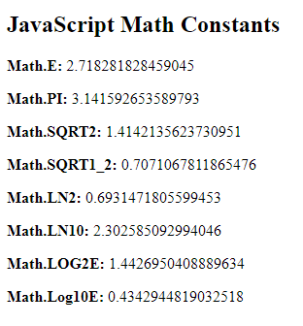
Math Propery Example
<html>
<body>
<h2>JavaScript Math Constants</h2>
<p id="demo"></p>
<script>
document.getElementById("demo").innerHTML =
"<p><b>Math.E:</b> " + Math.E + "</p>" +
"<p><b>Math.PI:</b> " + Math.PI + "</p>" +
"<p><b>Math.SQRT2:</b> " + Math.SQRT2 + "</p>" +
"<p><b>Math.SQRT1_2:</b> " + Math.SQRT1_2 + "</p>" +
"<p><b>Math.LN2:</b> " + Math.LN2 + "</p>" +
"<p><b>Math.LN10:</b> " + Math.LN10 + "</p>" +
"<p><b>Math.LOG2E:</b> " + Math.LOG2E + "</p>" +
"<p><b>Math.Log10E:</b> " + Math.LOG10E + "</p>";
</script>
</body>
</html>

Slide 4
Math Methods
abs()
max()
min()
pow()
round()
sqrt()

Slide 5
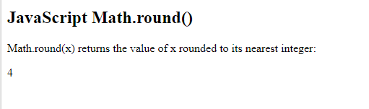
Math.round()
<html>
<body>
<h2>JavaScript Math.round()</h2>
<p>Math.round(x) returns the value of x rounded to its nearest integer:</p>
<p id="demo"></p>
<script>
document.getElementById("demo").innerHTML = Math.round(4.4);
</script>
</body>
</html>

Slide 6
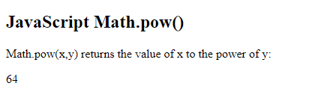
Math.pow()
<html>
<body>
<h2>JavaScript Math.pow()</h2>
<p>Math.pow(x,y) returns the value of x to the power of y:</p>
<p id="demo"></p>
<script>
document.getElementById("demo").innerHTML = Math.pow(8,2);
</script>
</body>
</html>

Slide 7
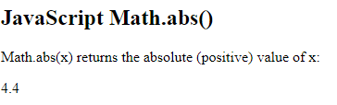
Math.abs()
<html>
<body>
<h2>JavaScript Math.abs()</h2>
<p>Math.abs(x) returns the absolute (positive) value of x:</p>
<p id="demo"></p>
<script>
document.getElementById("demo").innerHTML = Math.abs(-4.4);
</script>
</body>
</html>

Slide 8
The Boolean Object
The Boolean object represents two values, either "true" or "false".
If value parameter is omitted or is 0, -0, null, false, NaN, undefined, or the empty string (""), the object has an initial value of false.
Syntax
var val = new Boolean(value);

Slide 9
Boolean Methods
toString():
Returns a string of either “true” or “false”.

Slide 10
Example
<html>
<head>
<title>JavaScript toString() Method</title>
</head>
<body>
<script type="text/javascript"> var flag = new Boolean(false); document.write( "flag.toString is : " + flag.toString() );
</script>
</body>
</html>
Output
flag.toString is : false

Slide 11
The Arrays Object
The Array object lets you store multiple values in a single variable.
It stores a fixed-size sequential collection of elements of the same type.
An array is used to store a collection of data, but it is often more useful to think of an array as a collection of variables of the same type.
Syntax
var fruits = new Array( "apple", "orange", "mango" );
The Array parameter is a list of strings or integers.
When you specify a single numeric parameter with the Array constructor, you specify the initial length of the array.

Slide 12
Array Properties
length:
Returns the number of elements in an array.

Slide 13
Example
<html>
<head>
<title>JavaScript Array length Property</title>
</head>
<body>
<script type="text/javascript"> var arr = new Array( 10, 20, 30 );
document.write("arr.length is : " + arr.length);
</script>
</body>
</html>
Output
arr.length is : 3

Slide 14
Array Methods
concate():
Joins two or more arrays, return a join array.
join()
Joins all elements of an array into a string.

Slide 15
Example
<html>
<head>
<title>JavaScript Array concat Method</title>
</head>
<body>
<script type="text/javascript">
var alpha = ["a", "b", "c"];
var numeric = [1, 2, 3];
var alphaNumeric = alpha.concat(numeric);
document.write("alphaNumeric : " + alphaNumeric );
</script>
</body>
</html>
Output
alphaNumeric : a,b,c,1,2,3

Slide 16
Array join() Method
<html>
<head>
<title>JavaScript Array join Method</title>
</head>
<body>
<script type="text/javascript">
var arr = new Array("First","Second","Third");
var str = arr.join();
document.write("str : " + str );
var str = arr.join(", ");
document.write("<br />str : " + str );
var str = arr.join(" + ");
document.write("<br />str : " + str );
</script>
</body>
</html>
Output
str : First,Second,Third
str : First, Second, Third
str : First + Second + Third

Slide 17
The Date Object
The Date object is a datatype built into the JavaScript language.
Date objects are created with the new Date( ) as shown below.
Once a Date object is created, a number of methods allow you to operate on it.
Most methods simply allow you to get and set the year, month, day, hour, minute, second, and millisecond fields of the object, using either local time or UTC (universal, or GMT) time.
Syntax
new Date( )
new Date(milliseconds)
new Date(datestring)
new Date(year,month,date[,hour,minute,second,millisecond ])

Slide 18
Date Methods
getFullYear(): 4 Digits
getHours(): from 0-23
getDate(): Returns the day of the month (from 1-31)

Slide 19
Example
<script type=“text/javascript”>
Var mydate = new Date()
Var theyear = mydate.getFullYear()
Var themonth = mydate.getMonth()
Var thetoday = mydate.getDate()
Document.write(“Today’s date is: ”)
Document.write(theyear+”/”+ themonth+”/”+thetoday)
OutPut
Today’s date is: 2013/12/28

Slide 20
String Object
Work with a series of characters.
Allows you to perform manipulations on a stored piece of text like extracting a substring.
Var val=new String(string); // Creating string object
Method
substr()

Slide 21
Example
<html>
<head>
<title>JavaScript String substr() Method</title>
</head>
<body>
<script type="text/javascript">
var str = "Apples are round, and apples are juicy.";
document.write("(1,2): " + str.substr(1,2));
document.write("<br />(- 2,2): " + str.substr(-2,2));
document.write("<br />(1): " + str.substr(1));
document.write("<br />(-20, 2): " + str.substr(-20,2));
document.write("<br />(20, 2): " + str.substr(20,2));
</script>
</body>
</html>
Output
(1,2): pp
(-2,2): y.
(1): pples are round, and apples are juicy.
(-20, 2): nd
(20, 2): d

Slide 22
Regular Expressions and RegExp Object
A regular expression is an object that describes a pattern of characters.
The JavaScript RegExp class represents regular expressions, and both String and RegExp define methods that use regular expressions to perform powerful pattern-matching and search-and-replace functions on text.
Syntax
var pattern = new RegExp(pattern, attributes); or simply var pattern = /pattern/attributes;
Here is the description of the parameters −
pattern − A string that specifies the pattern of the regular expression or another regular expression.
attributes − An optional string containing any of the "g", "i", and "m" attributes that specify global, case-
insensitive, and multiline matches, respectively.

Slide 23
Example
<html>
<head>
<title>JavaScript RegExp exec Method</title>
</head>
<body>
<script type="text/javascript">
var str = "Javascript is an interesting scripting language";
var re = new RegExp( "script”);
var result = re.exec(str);
document.write("Test 1 - returned value : " + result);
re = new RegExp( "pushing”);
var result = re.exec(str);
document.write("<br />Test 2 - returned value : " + result);
</script>
</body>
</html>
Output
Test 1 - returned value : script
Test 2 - returned value : null

Slide 24
Attribute
g: Perform a global match (find all matches rather than stopping after
the first match)
i: Perform case-insensitive matching
m: Perform multiline matching

